Slide 1
Efficient Regression Testing in Continuous Integration Pipelines
An Industrial Case Study
Student: Diego Joshua Martínez Pineda
Supervisor: Mahsa Varshosaz

Slide 2

Introduction and Background

Slide 3

Our case study
An Enterprise Resource Planning software system for Small and Medium-sized Businesses
Developed by Microsoft
A large software system with long history

Slide 4
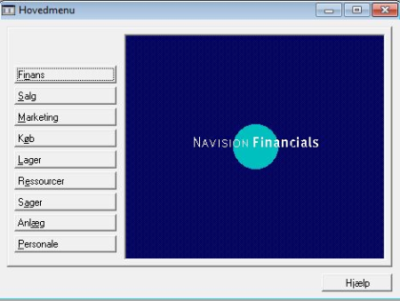
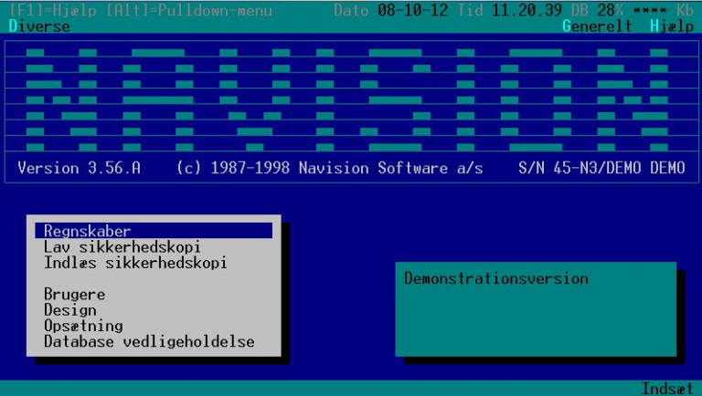
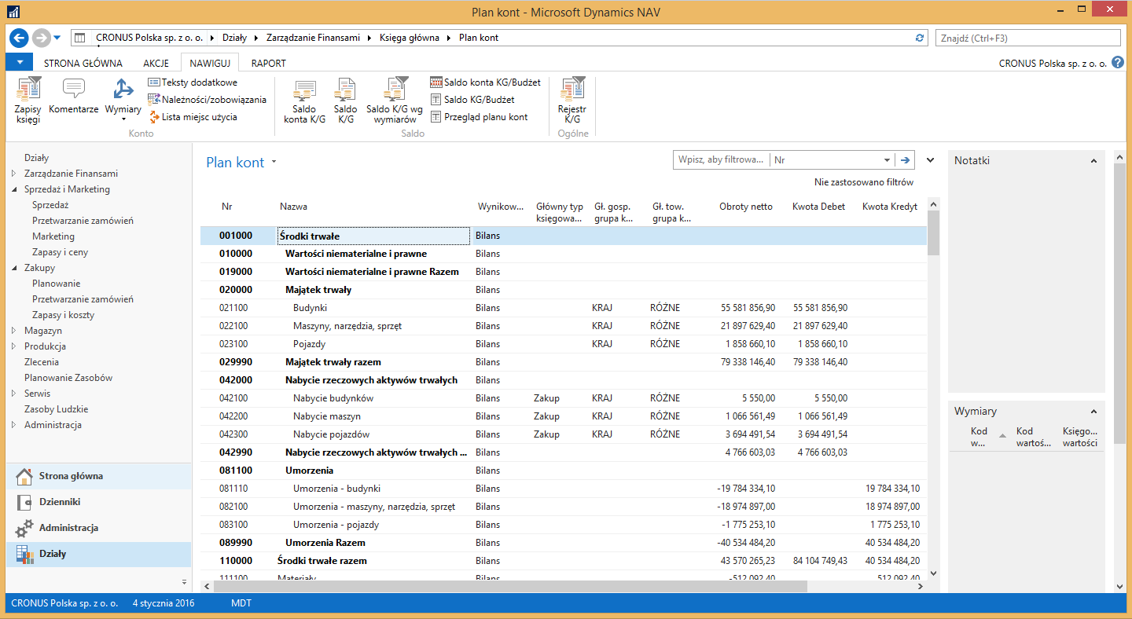
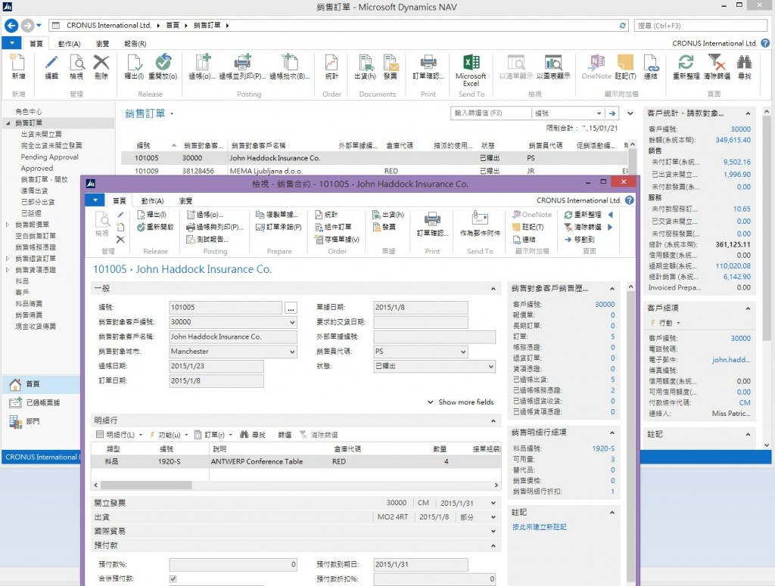
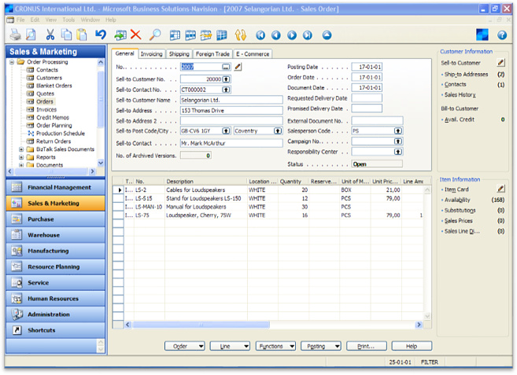
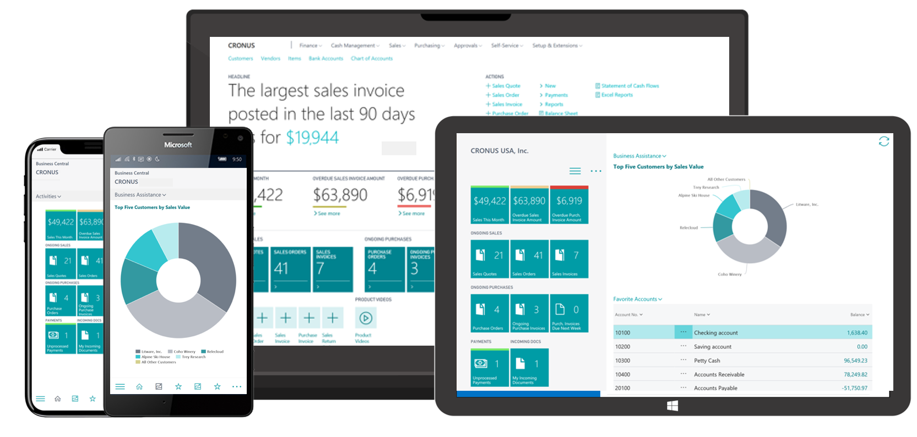
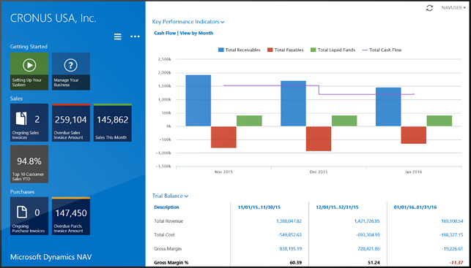
Business Central

Slide 5




Making Software is Hard
Business Central

Slide 6
Making Software is Hard
Business Central

Slide 7


How to Ensure Software Quality?
Scenarios
Automated Regression Testing

Slide 8
How to Ensure Software Quality?
Build
Build Tests
Setup Test Data
Test
Version Control

Slide 9
How to Ensure Software Quality?
Continuous Integration Pipelines

Slide 10
How to Ensure Software Quality?
Notes:
The problem is that as the system evolves, the number of regression tests also grows

Slide 11
How to Ensure Software Quality?
Notes:
In the case of BC with over 18000 tests to run, each of these cycles take 3 days for a single machine to execute

Slide 12
Business Central
Application
Platform
Control Plane
AL Language Infrastructure
…

Slide 13
Business Central
Application
Platform
Control Plane
AL Language Infrastructure
…
Notes:
Let’s see what can we do about it

Slide 14
Test Selection and Prioritization Techniques

Slide 15


Test Selection and Prioritization Techniques

Slide 16
Test Selection and Prioritization Techniques

Slide 17
Test Selection and Prioritization Techniques
Selection

Slide 18
Test Selection and Prioritization Techniques

Slide 19
Test Selection and Prioritization Techniques

Slide 20
Test Selection and Prioritization Techniques

Slide 21
Test Selection and Prioritization Techniques

Slide 22
Test Selection and Prioritization Techniques
Test execution

Slide 23
Test Selection and Prioritization Techniques
Test execution

Slide 24
Test Selection and Prioritization Techniques
Test execution

Slide 25
Test Selection and Prioritization Techniques
Prioritization
Test execution

Slide 26
Test Selection and Prioritization Techniques
A prioritization induces selections
Test execution
Notes:
How could we do prioritization? What criteria to use to find a sorting of these tests?

Slide 27




Test Coverage information
Execution traces of all lines of the codebase that the tests execution traverses
Which lines is the test affecting
Tests
Codebase
Notes:
I’ll introduce one of these features

Slide 28
Test Coverage information
Execution traces of all lines of the codebase that the tests execution traverses
Which lines is the test affecting
Tests
Codebase

Slide 29
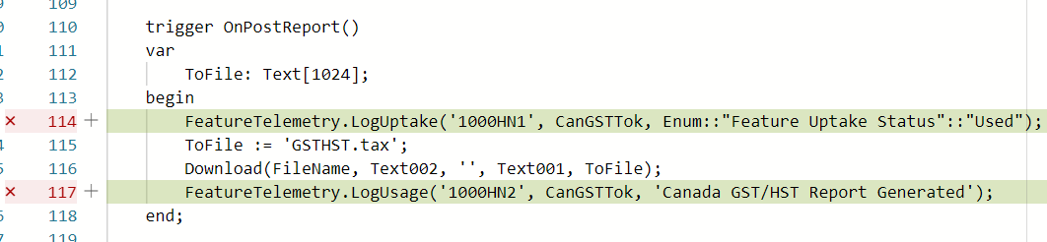
Test Coverage information

Slide 30


Learning-to-Rank techniques
-
-

Slide 31
Learning-to-Rank for Test Prioritization

Slide 32
Learning-to-Rank
Training Examples
q1 : x4, x5, x2, x1, x8
Learning system
q2 : x3, x1, x4, x2
q3 : x9, x8, x2, x5, x6
…
Model
Unseen query
Predicted ranking
Ranking system
q5
q5 : x1, x3, x4, x2

Slide 33












Learning-to-Rank
q2 : x3, x1, x4, x2
Tests
$$(1.43, 3.4, 9.1, 7.9, 0, 0, 1.3)$$
$$Priority=5$$
Change to the codebase
$$(5.1, 0.4, 9.1, 7.9, 0.1, 0, 3.2)$$
$$Priority=2$$
$$(1.3, 1.9, 941, 2.3, 0, 2, 2.1)$$
$$Priority=9$$
$$(9.13, 13.2, 4.1, 3.4, 1, 1, 3)$$
$$Priority=1$$

Slide 34

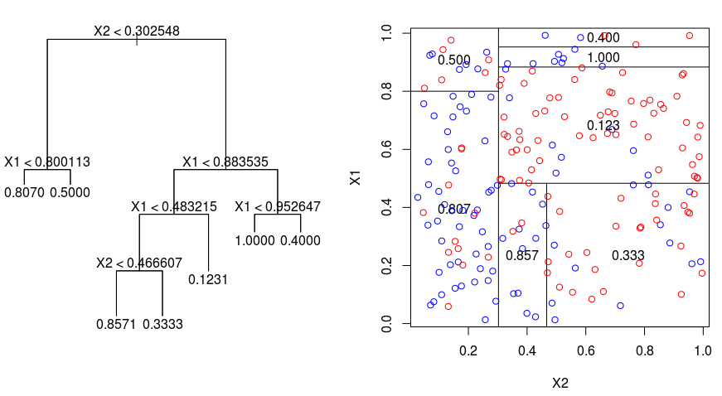
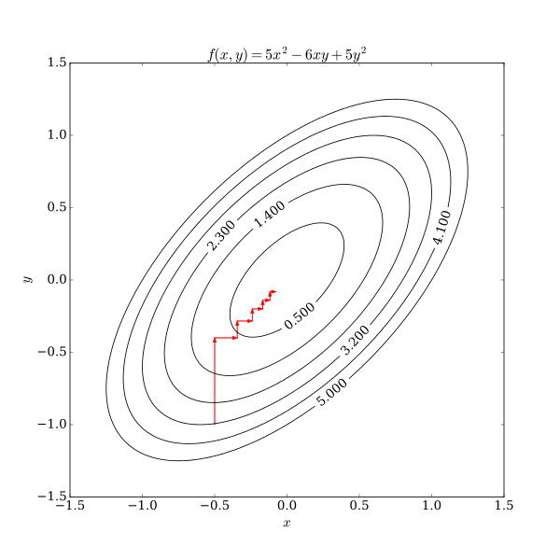
Learning-to-Rank
Techniques explored:
Coordinate Ascent
LambdaMART
MART
AdaRank
RankBoost

Slide 35
Learning-to-Rank
Metrics for ranking:
Discounted Cumulative Gain (DCG)
Normalized Discounted Cumulative Gain (NDGC)
Mean Average Percentage (MAP)
Expected Reciprocal Rank (ERR)

Slide 36
Research Questions
RQ1: What Learning-to-Rank technique for the Test Prioritization yields the best results for this pipeline?
RQ2: To what extent the number of tests and their execution time can be reduced?
RQ3: What is the effect of using test coverage information for these approaches?

Slide 37
Method

Slide 38
Overview
Collect information from the build system of this pipeline
Collect test coverage information
Obtain vector representations of the change and tests
Prioritize the training dataset
Train the different ranking models, with different hyperparameters
Evaluate the models with test prioritization metrics

Slide 39
Overview
Collect information from the build system of this pipeline
Collect test coverage information
Obtain vector representations of the change and tests
Prioritize the training dataset
Training the different ranking models, with different hyperparameters
Evaluate the models with test prioritization metrics

Slide 40
Collecting information
CI History
Test Coverage
Infrastructure to collect the CI information from the build system over a time interval was developed
Over a week, collection of the CI jobs submitted was performed
172 CI jobs were collected, each job contained results of around 18000 test executions
In between, test coverage information was obtained by submitting appropriate jobs to the build system

Slide 41
Collecting information: CI history
Job execution properties: tasks executed, duration, result and date
For each test task, the result and duration of each of the test units
Files before and after the change

Slide 42
Collecting information: Test coverage
One of the test runners could not produce coverage information
Modifications were implemented to allow for collecting it
Coverage collecting jobs were submitted and downloaded in the collection time span

Slide 43
Overview
Collect information from the build system of this pipeline
Collect test coverage information
Obtain vector representations of the change and tests
Prioritize the training dataset
Training the different ranking models, with different hyperparameters
Evaluate the models with test prioritization metrics

Slide 44




Representing tests and codebase changes
Tests
$$(1.43, 3.4, 9.1, 7.9, 0, 0, 1.3)$$
Change to the codebase
$$(5.1, 0.4, 9.1, 7.9, 0.1, 0, 3.2)$$
$$(1.3, 1.9, 941, 2.3, 0, 2, 2.1)$$
$$(9.13, 13.2, 4.1, 3.4, 1, 1, 3)$$

Slide 45
Representing tests and codebase changes
Properties of the AL codebase:
New, modified, removed AL tables, objects, and tests
Test history properties:
Proportion of times failed, within a time window
Average duration in previous executions
Test coverage properties:
Number of changed files covered by a test
Number of lines covered, normalized
Number of changed lines covered by a test
With RQ3 as our goal, datasets with and without it were created

Slide 46
Overview
Collect information from the build system of this pipeline
Collect test coverage information
Obtain vector representations of the change and tests
Prioritize the training dataset
Training the different ranking models, with different hyperparameters
Evaluate the models with test prioritization metrics

Slide 47








Prioritize the training dataset
$$(1.43, 3.4, 9.1, 7.9, 0, 0, 1.3)$$
$$Priority=5$$
$$(5.1, 0.4, 9.1, 7.9, 0.1, 0, 3.2)$$
$$Priority=2$$
$$(1.3, 1.9, 941, 2.3, 0, 2, 2.1)$$
$$Priority=9$$
$$(9.13, 13.2, 4.1, 3.4, 1, 1, 3)$$
$$Priority=1$$

Slide 48

Prioritize the training dataset
Bertolino, et. al. proposal:
Discrete test coverage:
Failing tests
New or modified tests
Tests without coverage information
Tests covering changed lines
Other tests
$$R_{i}=F_{i}+e^{−T_{i}}$$
Different datasets with each were created to support RQ3

Slide 49
Learning to Rank
Training Examples
q1 : x4, x5, x2, x1, x8
Learning system
q2 : x3, x1, x4, x2
q3 : x9, x8, x2, x5, x6
…
Model
Unseen query
Predicted ranking
Ranking system
q5
q5 : x1, x3, x4, x2

Slide 50
Overview
Collect information from the build system of this pipeline
Collect test coverage information
Obtain vector representations of the change and tests
Prioritize the training dataset
Training the different ranking models, with different hyperparameters
Evaluate the models with test prioritization metrics

Slide 51
Training the different ranking models
With the different datasets:
Name | Features | Prioritization
EP-CI | AL properties Test history properties Coverage properties | Exponential
EP-NCI | AL properties Test history properties | Exponential
CP-CI | AL properties Test history properties Coverage properties | Discrete Coverage
CP-NCI | AL properties Test history properties | Discrete Coverage

Slide 52
Training the different ranking models
Training of the following ranking algorithms was performed:
Coordinate Ascent
LambdaMART
MART
AdaRank / RankBoost (no valid model obtained)
Different ranking training metrics
For methods using regression trees, we trained with different number of trees
Training using Ranklib implementations on ITU’s High Performance Cluster
Every dataset was trained with every combination of model, hyperparameters, and ranking training metrics

Slide 53
Overview
Collect information from the build system of this pipeline
Collect test coverage information
Obtain vector representations of the change and tests
Prioritize the training dataset
Training the different ranking models, with different hyperparameters
Evaluate the models with test prioritization metrics

Slide 54
Evaluating the prioritizations
Metrics for selection:
Test selection execution time
Inclusiveness
Selection size
Metrics for prioritization:
Time to the first failure
Normalized Average Percentage of Faults Detected (NAPFD)

Slide 55
NAPFD

Slide 56
NAPFD

Slide 57
Time to the first failure

Slide 58
Time to the first failure

Slide 59

Induced Selections
Inclusiveness
Selection execution time

Slide 60
Induced Selections
Inclusiveness
Selection execution time

Slide 61
Induced Selections
Inclusiveness
Selection execution time

Slide 62
Conclusion

Slide 63
Research Questions
RQ1: What Learning-to-Rank technique for the Test Prioritization yields the best results for this pipeline?
RQ2: To what extent the number of tests and their execution time can be reduced?
RQ3: What is the effect of using test coverage information for these approaches?

Slide 64
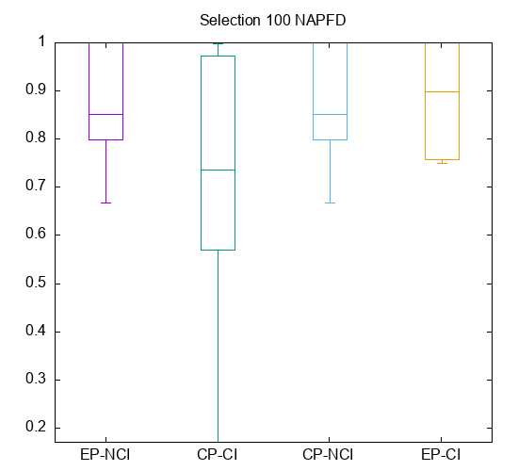
Coordinate Ascent
Training metric: NDCG@30
CP-NCI dataset best and most consistent behavior for NAPFD

Slide 65
Research Questions
RQ1: What Learning-to-Rank technique for the Test Prioritization yields the best results for this pipeline?
RQ2: To what extent the number of tests and their execution time can be reduced?
RQ3: What is the effect of using test coverage information for these approaches?

Slide 66
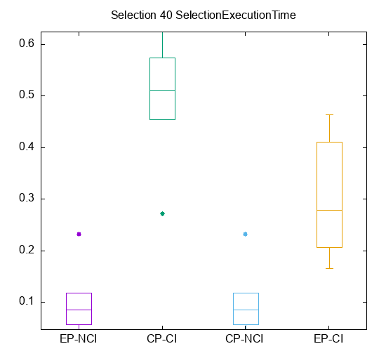
A safe selection
Which induced selection (10%, 20%, …) wouldn’t miss any failing tests?
For Coordinate Ascent optimizing NDCG@30, and the CP-NCI dataset: 40%
The corresponding selection execution time: 10% in average

Slide 67
Research Questions
RQ1: What Learning-to-Rank technique for the Test Prioritization yields the best results for this pipeline?
RQ2: To what extent the number of tests and their execution time can be reduced?
RQ3: What is the effect of using test coverage information for these approaches?

Slide 68
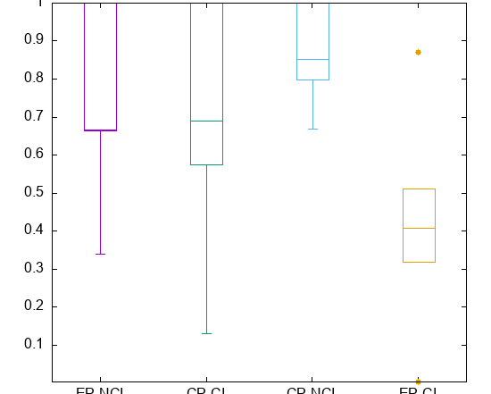
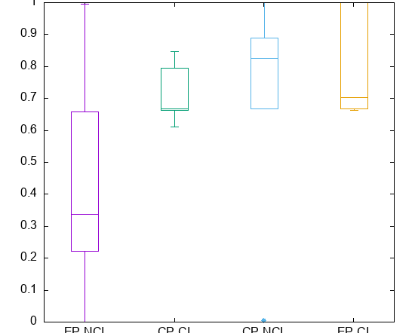
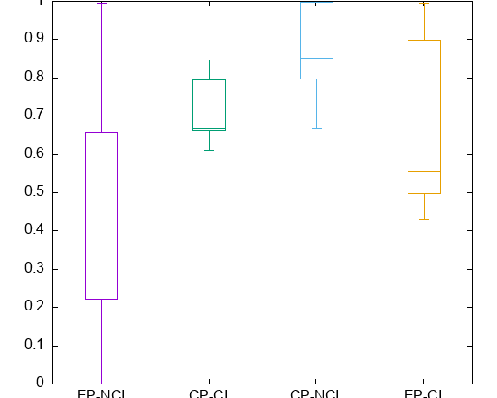
Comparing datasets
Across algorithm configurations, the best NAPFD values were obtained by the configuration using:
Discrete coverage prioritization
Not using coverage as part of the features

Slide 69
Future work
More robust dataset for evaluation
Other features to represent codebase changes and tests
Evaluation of Reinforcement Learning approaches
Other pipeline optimization techniques
Required changes on the existing build system to use proposed prioritizations

